Slide 1
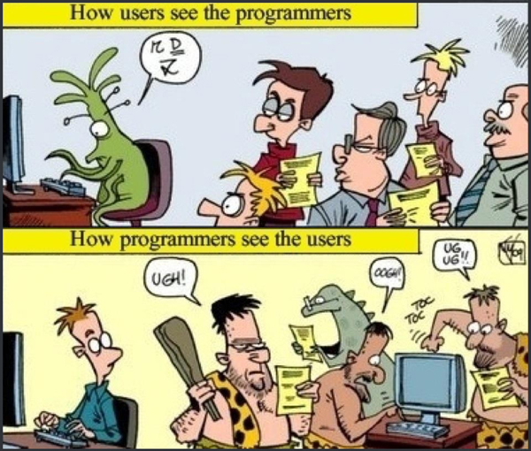

Slide 2
Highlights of Chapter 2
System.out.print(), ...println()
Strings
Variables
Primitive data types
byte, short, int, long, char, float, double, boolean
Operators
., +, +, -, *, /, /, %, ++, --, =, +=, ...
Objects and classes
The Scanner class
import java.util.Scanner;
next(), nextln(), nextInt(), nextDouble(), ...
Type conversions
byte < short < int < float < double
Good programming habits, especially indentation

Slide 3
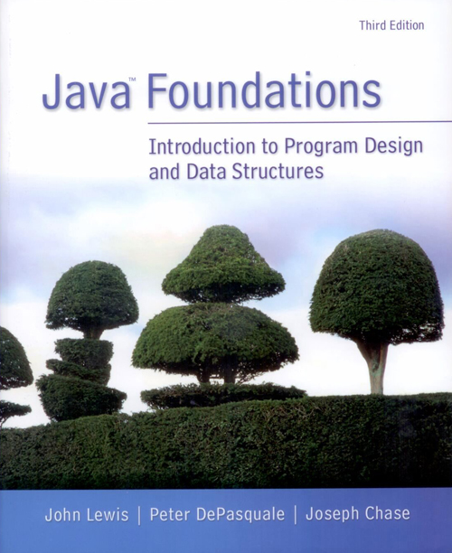
Chapter 3
Using Classes and Objects

Slide 4
Objectives
Discuss the creation of object and the use of object reference variables
Explore the services provided by the String class
Describe how the Java standard class library is organized into packages
Explore the services provided by the Random and Math classes
Discuss ways to format output using the NumberFormat and DecimalFormat classes
Introduce enumerated types
Discuss wrapper classes and the concept of autoboxing

Slide 5
Content
Creating objects
The String class
Packages
The Random class
The Math class
Formatting output
Enumerated types
Wrapper classes

Slide 6
1. Creating Objects
A variable holds either a primitive type or a reference to an object.
A class name can be used as a type to declare an object reference variable.
String title; Scanner scan;
No object is created with this declaration.
An object reference variable holds the address of an object.
The object itself must be created separately.

Slide 7
Generally, we use the new operator to create an object:
String title;
title = new String("James Gosling");
Scanner scan = new Scanner(System.in);
Creating an object is called instantiation.
An object is an instance of a particular class.
This calls the String constructor, which is
a special method that sets up the object.
Notes:
Instance: an occurrence of something; an item of information that is typical of a class or group

Slide 8
Creating Strings
Because strings are so common, we don't have to use the new operator to create a String object.
String title = "Java rocks!"; // It is also okay.
String anotherTitle = new String("Java rocks!");
This is special syntax that works only for strings.
Each string literal (enclosed in double quotes) represents a String object.

Slide 9
Invoking (oac Calling) Methods
We've seen that once an object has been instantiated, we can use the dot operator to invoke (oac call) its methods. (Actually the . operator means that methods belong to the object. () means the actual invocation of the methods.)
String title = "Java rocks!";
int count;
int first;
count = title.length(); // It means (title.length)()
System.out.println("The length of \"" + title +
"\" is " + title.length() + ".");
first = scan.nextInt();
A method may return a value, which can be used in an assignment or expression.
A method invocation can be thought of as asking an object to perform a service.
Notes:
Invoke: summon into action or bring into existence, often as if by magic

Slide 10
Object References
A primitive variable contains the value itself.
An object variable contains the address of the object.
An object reference can be thought of as a pointer to the location of the object in main memory.
Rather than dealing with arbitrary addresses, we often depict a reference graphically.
num1
38
name1
"Elon Musk"

Slide 11
Assignment Revisited
The act of assignment takes a copy of a value and stores it in a variable.
For primitive types:
num1
38
Before:
num2
96
num2 = num1;
num1 = 27;
num1
27
After:
num2
38

Slide 12
For object references, the address is copied, not the object:
98
name1
98
"Steve Jobs"
Before:
27
name2
27
"Steve Wonder"
name2 = name1;
98
name1
98
"Steve Jobs"
After:
name2
98

Slide 13
String s1 = "Steve Jobs";
String s2 = "Steve Wonder";
System.out.println(s2); // ???
s2 = s1;
System.out.println(s2); // ???
String s3 = "Wow!";
String s4 = "Wow!";
System.out.println(s4); // ???
s3 = "Wonderful!";
System.out.println(s4); // ???

Slide 14
1.1 Aliases
Two or more references that refer to the same object are called aliases of each other.
That creates an interesting situation: one object can be accessed using multiple reference variables.
Aliases can be useful, but should be managed carefully.
Changing an object through one reference changes it for all of its aliases, because there is really only one object. We will see some examples later.

Slide 15
Garbage Collection
When an object no longer has any valid references to it, it can no longer be accessed by the program.
The object is useless, and therefore is called garbage.
Java performs automatic garbage collection periodically, returning an object's memory to the system for future use.
In some old languages, the programmer is responsible for performing garbage collection explicitly.

Slide 16
public static void main(String[] args)
{
String s1, s2;
s1 = "What a wonderful world!";
s2 = "What a beautiful day!";
s2 = s1;
System.out.println(s1); // ???
System.out.println(s2); // ???
}
What will happened to the String object - "What a beautiful day!"?

Slide 17
Content
Creating objects
The String class
Packages
The Random class
The Math class
Formatting output
Enumerated types
Wrapper classes

Slide 18
2. The String Class
Once a String object has been created, neither its value nor its length can be changed. (Note that a string variable can be assigned with another string.)
Thus we say that an object of the String class is immutable.
However, several methods of the String class return new String objects that are modified versions of the original.

Slide 19
It is occasionally helpful to refer to a particular character within a string.
This can be done by specifying the character's numeric index.
The indexes begin at zero in each string.
In the string "Hello", the character 'H' is at index 0 and the 'o' is at index 4. (Note that the index of the last character is the length of the string minus 1.)

Slide 20
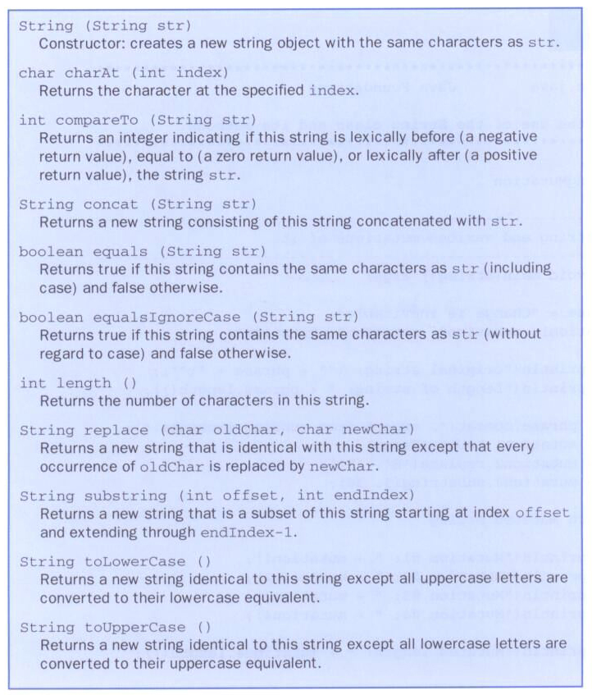
Methods
charAt()
length()
substring()
toLowerCase()
toUpperCase()
replace()
equals()
...

Slide 21
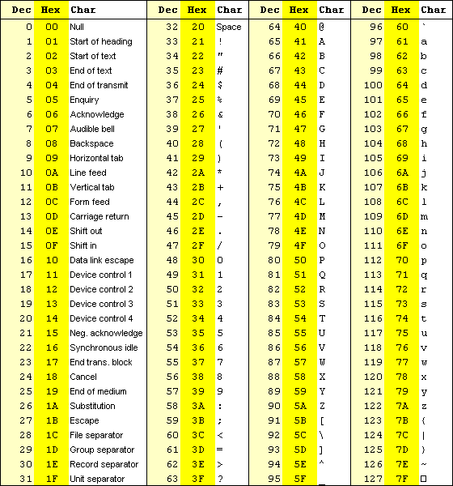
ASCII table

Slide 22
public class StringMutation
{
public static void main(String[] args)
{
String phrase = "Change is inevitable";
String mutation1, mutation2, mutation3, mutation4, mutation5;
System.out.println("Original string: \"" + phrase + "\"");
System.out.println("Length of string: " + phrase.length());
mutation1 = phrase.concat(", except from vending machines.");
mutation5 = phrase ??? ", except from vending machines.";
mutation2 = mutation1.toUpperCase();
mutation3 = mutation2.replace('E', 'X');
mutation4 = mutation3.substring(3, 30); // from index 3 to index 29.
System.out.println("Mutation #1: " + mutation1);
System.out.println("Mutation #5: " + mutation5);
System.out.println("Mutation #2: " + mutation2);
System.out.println("Mutation #3: " + mutation3);
System.out.println("Mutation #4: " + mutation4);
System.out.println("Mutated length: " + mutation4.???);
}
}
[Q] Outputs?
[X] Let’s try this program.

Slide 23
[Q] Can you replace a character at a certain index by another character?
Example: How to replace the 1st 'y' by 'e', not all 'y'?
String name = "Stevy Jobssy";
You can use the method, substring().
String newName;
newName = name.substring(0,4) +
'e' +
name.substring(5,name.???);
System.out.println(newName); // Output?

Slide 24
Content
Creating objects
The String class
Packages
The Random class
The Math class
Formatting output
Enumerated types
Wrapper classes

Slide 25
3. Packages
[Q] Where are System, String and Scanner defined?
Notes:
API, an abbreviation of application program interface, is a set of routines, protocols, and tools for building software applications. The API specifies how software components should interact and APIs are used when programming graphical user interface (GUI) components.

Slide 26
The Java API
A class library is a collection of classes that we can use when developing programs.
The Java API is the standard class library that is part of any Java development environment.
API stands for Application Programming Interface.
Various classes we've already used (System , Scanner, String) are part of the Java API.
Other class libraries can be obtained through third party vendors, or you can create them yourself.
Notes:
API, an abbreviation of application program interface, is a set of routines, protocols, and tools for building software applications. The API specifies how software components should interact and APIs are used when programming graphical user interface (GUI) components.

Slide 27
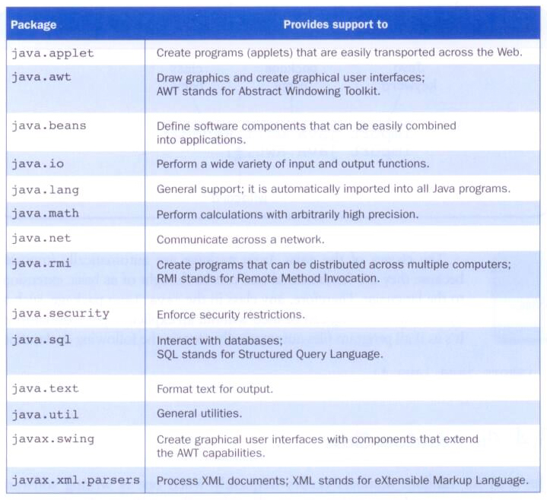
Packages
The classes of the Java API are organized into packages.

Slide 28
Import Declarations
When you want to use a class from a package, you could use its fully qualified name.
java.util.Scanner scan =
new java.util.Scanner(System.in);
Or you can import the class before class definition, and then use just the class name: (Note that it is most common.)
import java.util.Scanner;
public class ...
{
...
Scanner scan = new Scanner(System.in);
To import all classes in a particular package, you can use the * wildcard character:
import java.util.*;

Slide 29
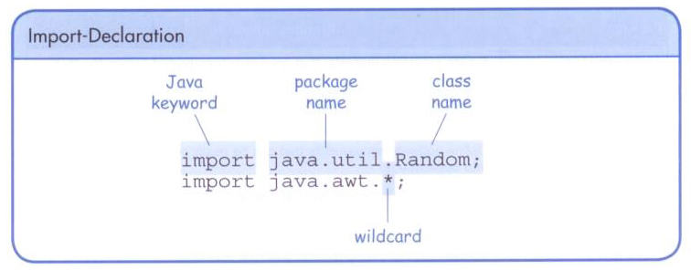

Slide 30
The java.lang Package
All classes of the java.lang package are imported automatically into all programs.
It's as if all programs contain the following line.
import java.lang.*;
That's why we didn't have to import the System or String classes explicitly in earlier programs.
The Scanner class, on the other hand, is part of the java.util package, and therefore must be imported.

Slide 31
Intermediate Summary
How to create an object of a class
new ClassName(...)
String methods
length(), charAt(), substring(), equal(), ...
Packages
import java.util.* for Scanner, Random, …

Slide 32
Content
Creating objects
The String class
Packages
The Random class
The Math class
Formatting output
Enumerated types
Wrapper classes

Slide 33
4. The Random Class
The Random class is a part of the java.util package. (Do we have to import this class?)
It provides methods that generate pseudo random numbers.
A Random object performs complicated calculations based on a seed value to produce a stream of seemingly random values.
Notes:
An instance of this class is used to generate a stream of pseudorandom numbers. The class uses a 48-bit seed, which is modified using a linear congruential formula. (See Donald Knuth,The Art of Computer Programming, Volume 2, Section 3.2.1.)
The java.util.Random class implements what is generally called a linear congruential generator (LCG). An LCG is essentially a formula of the following form:
number_{i+1} = (a * number_{i} + c) mod m
The period of the java.util.Random generator is 2⁴⁸. In decimal, 2⁴⁸ is a few hundred million million.

Slide 34
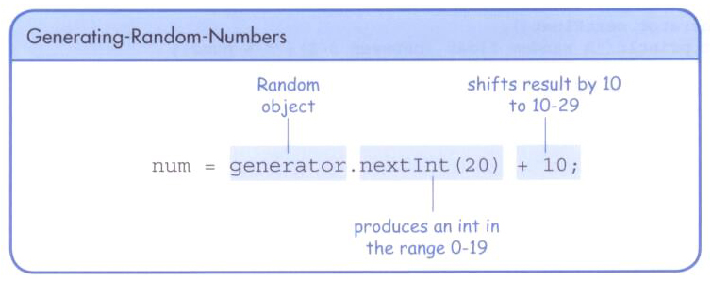
Some methods of the Random class:
[0, 1)
[0, num)
How to declare ‘generator’ below and create a Random object?
Random generator = new Random();
[10, 30)
What numbers will be generated?
[0, 20)

Slide 35
??? java.util.Random;
public class RandomNumbers
{
public static void main(String[] args)
{
Random generator = new ???();
int num1;
double num2;
num1 = generator.???; // random integer
System.out.println("A random integer: " + num1);
num1 = generator.nextInt(10);
System.out.println("From 0 to 9: " + num1);
num1 = generator.nextInt(10) + 1;
System.out.println("From 1 to 10: " + num1);
num1 = generator.nextInt(???) + ???;
System.out.println("From 20 to 34: " + num1);
num1 = generator.nextInt(???) + ???;
System.out.println("From -10 to 9: " + num1);
num2 = generator.nextFloat();
System.out.println("A random float (between 0-1): " + num2);
num2 = generator.??? * ???; // 0.0 to 5.999999
num1 = (int)num2 + 1; // Can you understand what (int) means?
System.out.println("From 1 to 6: " + num1);
}
}
[X] Let’s try this program.
Output?

Slide 36
Random Integer between a & b
How?
import java.util.Random;
...
int ranNum;
Random generator = new Random();
int scale = b – a + 1; // including a and
// b, i.e., [a, b]
ranNum = generator.nextInt(scale) + a;
...

Slide 37
E.g., Let’s generate a random integer number in [1, 6] to simulate ‘casting a die’.
a = 1;
b = 6;
scale = b – a + 1; // 1? Because b is included.
generator.nextInt(scale) + a;
[X] Try with RandomInt.java. You can download from the course Moodle page, fix some errors, compile, and run.
How to make a random floating point number in [5.0, 10.0)?
double scale = 10 – 5.0;
generator.nextFloat() * scale + 5;
[X] Try with RandomFloat.java.

Slide 38
Content
Creating objects
The String class
Packages
The Random class
The Math class
Formatting output
Enumerated types
Wrapper classes

Slide 39
5. The Math Class
The Math class is part of the java.lang package. (Do we have to import this class?)
The Math class contains methods that perform various mathematical functions.
These include:
absolute value
square root
exponentiation
trigonometric functions

Slide 40
The methods of the Math class are static methods (also called class methods).
Static methods can be invoked through the class name – NO object of the Math class is needed.
value = Math.cos(90) + Math.sqrt(delta);
We'll discuss static methods in more detail later.
Notes:
Normally you can't call a method of a class without first creating an instance of that class. By declaring a method using the static keyword, you can call it without first creating an object because it becomes a class method (i.e. a method that belongs to a class rather than an object).
Static methods are used for methods that do not need to access to an object's state or only use static fields. For example, the main method is a static method:
public static void main(String[] args)
It is the starting point for a Java application and does not need to access an object's state. In fact, there aren't any objects created at this point. Any parameters that it needs can be passed as a String array.

Slide 41
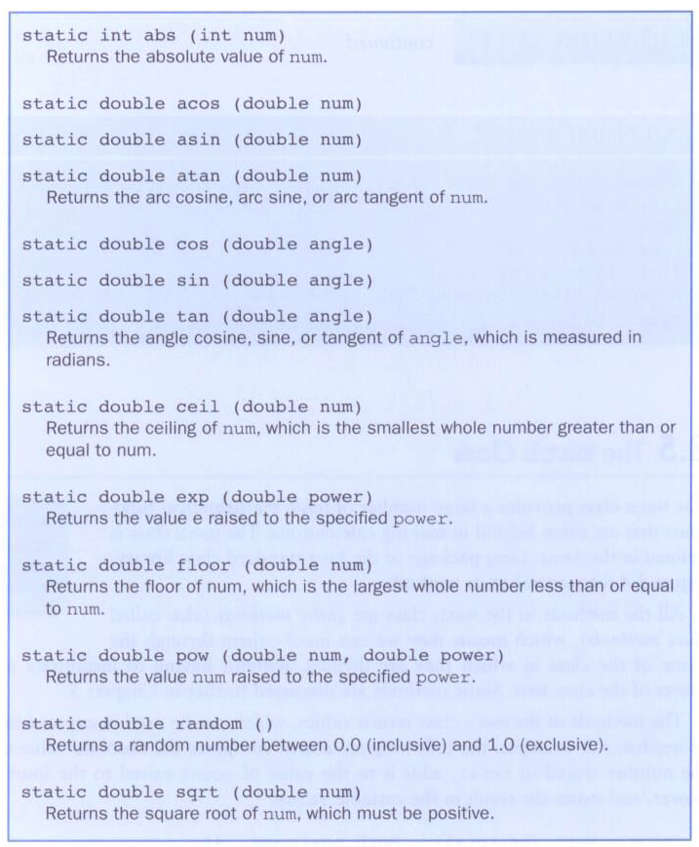
Some methods of the Math class:
abs()
ceil()
floor()
pow()
sqrt()
...
Constants:
PI
E
static double PI ...
Notes:
The radian is the standard unit of angular measure, used in many areas of mathematics. An angle's measurement in radians is numerically equal to the length of a corresponding arc of a unit circle; one radian is just under 57.3 degrees (when the arc length is equal to the radius).

Slide 42
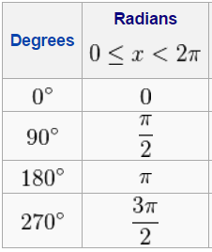
Sine Function
How to convert degrees to radians?
degrees / 360 * (2 * Math.PI)
How to convert radians to degrees?
???

Slide 43
How to Use Math.sin(angle)
public class SinTest{
public static void main(String[] args){
double degree = 90.0;
double radian = ???; // degree -> radian
System.out.print("sin(90)=" + ???.sin(radian));
}
}
[X] Let’s try this program.

Slide 44
Quadratic Equation

Slide 45
[X] Let’s try this program.
import java.util.Scanner;
public class Quadratic
{
public static void main(String[] args)
{
int a, b, c; // In Math, ax^2 + bx + c = 0
double discriminant, root1, root2;
Scanner scan = new Scanner(System.in);
System.out.print("Enter the coefficient of x squared: ");
a = scan.nextInt();
System.out.print("Enter the coefficient of x: ");
b = scan.nextInt();
System.out.print("Enter the constant: ");
c = scan.nextInt();
discriminant = Math.???(b, 2) - (4 * a * c);
root1 = ((-1 * b) + Math.???(discriminant)) / (2 * a);
root2 = (-b - Math.???(Math.???(b, 2) - (4 * a * c))) / (2 * a);
System.out.println("Root #1: " + root1);
System.out.println("Root #2: " + root2);
}
}
abs()
ceil()
floor()
pow()
sqrt()
Notes:
The discriminant is the name given to the expression that appears under the square root (radical) sign in the quadratic formula.

Slide 46
Ex. How to compute volume ($\frac{4}{3}πr^{3}$)
Scanner scan = new Scanner(System.in);
double r = scan.nextDouble(); // radius of a sphere
double volume;
volume = ???;
[X] Try with Volume.java.
Notes:
Normally you can't call a method of a class without first creating an instance of that class. By declaring a method using the static keyword, you can call it without first creating an object because it becomes a class method (i.e. a method that belongs to a class rather than an object).
Static methods are used for methods that do not need to access to an object's state or only use static fields. For example, the main method is a static method:
public static void main(String[] args)
It is the starting point for a Java application and does not need to access an object's state. In fact, there aren't any objects created at this point. Any parameters that it needs can be passed as a String array.

Slide 47
Ex. Write an application that reads the (x, y) coordinates for two points. Compute the distance between the two points.
$\sqrt{{\left(x1−x2\right)}^{2}+{\left(y1−y2\right)}^{2}}$
[X] Try with Distance.java.

Slide 48
Intermediate Summary
Random
nextFloat(), nextInt()
Math
floor(), ceil(), sqrt(), pow(), abs(), random(), PI

Slide 49
Content
Creating objects
The String class
Packages
The Random class
The Math class
Formatting output
Enumerated types
Wrapper classes

Slide 50
6. Formatting Output
It is often necessary to format values in certain ways so that they can be presented properly.
The Java API contains classes that provide formatting capabilities.
The NumberFormat class allows you to format values as currency or percentages.
The DecimalFormat class allows you to format values based on a pattern.
Both are part of the java.text package.

Slide 51
Meaning?
The NumberFormat class has static methods that return a formatter object.
getCurrencyInstance()
getPercentInstance()
Each formatter object has a method called format() that returns a string with the specified information in the appropriate format.

Slide 52
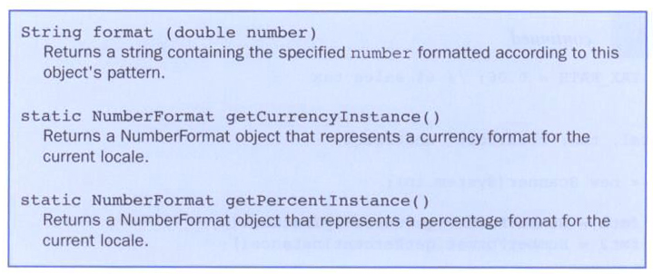
Some methods of the NumberFormat class:

Slide 53
import java.util.Scanner;
import java.text.NumberFormat;
public class Purchase
{
//-----------------------------------------------------------------
// Calculates the final price of a purchased item using values
// entered by the user.
//-----------------------------------------------------------------
public static void main(String[] args)
{
final double TAX_RATE = 0.06; // 6% sales tax
int quantity;
double subtotal, tax, totalCost, unitPrice;
Scanner scan = new Scanner(System.in);
NumberFormat fmt1 = NumberFormat.getCurrencyInstance();
NumberFormat fmt2 = NumberFormat.getPercentInstance();

Slide 54
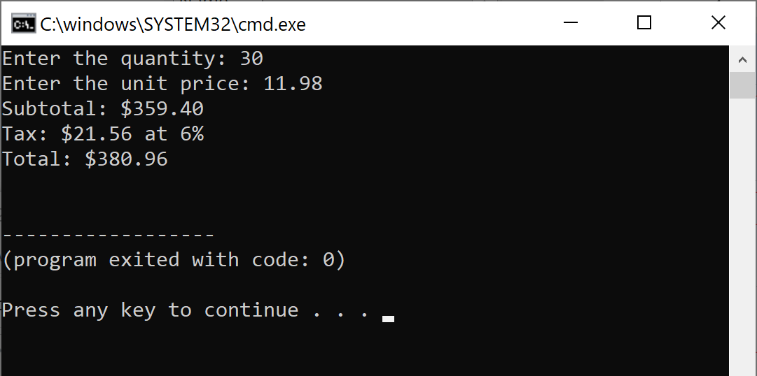
System.out.print("Enter the quantity: ");
quantity = scan.nextInt();
System.out.print("Enter the unit price: ");
unitPrice = scan.nextDouble();
subtotal = quantity * unitPrice;
tax = subtotal * TAX_RATE;
totalCost = subtotal + tax;
// Print output with appropriate formatting
System.out.println("Subtotal: " + fmt1.format(subtotal)); // currency
System.out.println("Tax: " + fmt1.format(tax) + " at "
+ fmt2.format(TAX_RATE)); // percentage
System.out.println("Total: " + fmt1.format(totalCost));
}
}
Try with Purchase.java.

Slide 55
The DecimalFormat class can be used to format a floating point value in various ways.
For example, you can specify that the number should be truncated to three decimal places.
The constructor of the DecimalFormat class takes a string that represents a pattern for the formatted number.

Slide 56
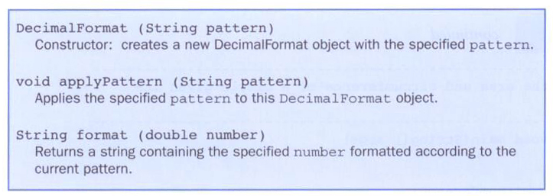
Some methods of the DecimalFormat class:

Slide 57
Pattern Examples

Slide 58
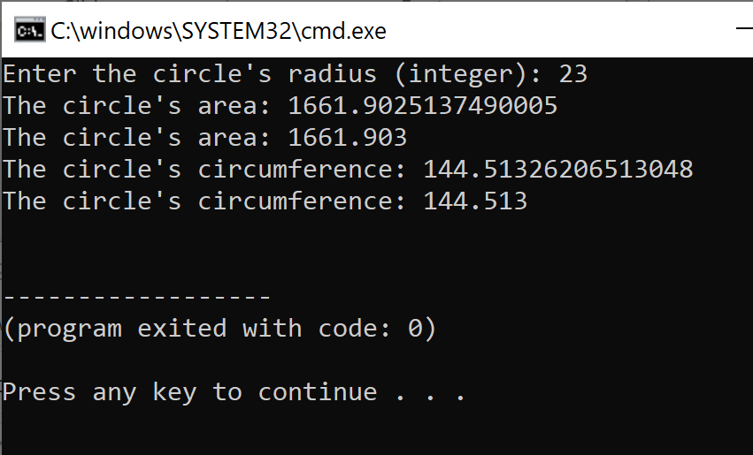
Try with CircleStats.java.
import java.util.Scanner;
import java.text.DecimalFormat;
public class CircleStats
{
public static void main(String[] args)
{
int radius;
double area, circumference;
Scanner scan = new Scanner(System.in);
System.out.print("Enter the circle's radius: ");
radius = scan.nextInt();
area = Math.PI * Math.pow(radius, 2);
circumference = 2 * Math.PI * radius;
// Round the output to three decimal places
DecimalFormat fmt = new DecimalFormat("0.###");
System.out.println("The circle's area: " + area)
System.out.println("The circle's area: " + fmt.format(area));
System.out.println("The circle's circumference: “
+ fmt.format(circumference));
}
}

Slide 59
Try this one too. Date.java.

Slide 60
NumberFormat vs. Decimal Format
import java.text.NumberFormat;
……
NumberFormat fmt =
NumberFormat.getCurrencyInstance();
NumberFormat fmt2 =
NumberFormat.getPercentInstance();
……
System.out.println(fmt.format(5000.99));
System.out.println(fmt2.format(0.5));
import java.text.DecimalFormat;
……
DecimalFormat fmt =
new DecimalFormat(" ###,###.##“);
……
System.out.println(fmt.format(2000.567));

Slide 61
printf() method
Old style
Allows the user to print a formatted string containing data values.
First parameter: represents the format string
Remaining parameters: specify the values that are inserted into the format string.
System.out.printf("ID: %5d\tName: %s", id, name);
ID: 24036 Name: Larry Flagelhopper
(d: decimal integer; s: String)
http://www.homeandlearn.co.uk/java/java_formatted_strings.html

Slide 62
Content
Creating objects
The String class
Packages
The Random class
The Math class
Formatting output
Enumerated types
Wrapper classes

Slide 63
7. Enumerated Types
Java allows you to define an enumerated type, which can then be used to declare variables.
An enumerated type establishes all possible values for a variable of that type.
The values are identifiers of your own choosing.
The following declaration creates an enumerated type called Season.
enum Season {winter, spring, summer, fall}
Any number of values can be listed.
Notes:
Enumerate: specify individually; determine the number or amount of; itemize; count

Slide 64
Once a type is defined, a variable of that type can be declared
enum Season {winter, spring, summer, fall}
...
Season time;
and it can be assigned a value.
time = Season.fall;
The values are specified through the name of the type.
Enumerated types are type-safe – you cannot assign any value other than those listed.

Slide 65
Internally, each value of an enumerated type is stored as an integer, called its ordinal value.
Why do you need ordinal value?
Values can be compared to see which one is bigger. Sorting can be possible.
The first value in an enumerated type has an ordinal value of zero, the second one, and so on.
However, you cannot assign a numeric value to an enumerated type, even if it corresponds to a valid ordinal value.

Slide 66
The declaration of an enumerated type is a special type of class, and each variable of that type is an object.
Should be declared before main()
The ordinal() method returns the ordinal value of the object.
The name() method returns the name of the identifier corresponding to the object's value.

Slide 67
public class IceCream
{
enum Flavor {vanilla, chocolate, strawberry, fudgeRipple, coffee,
rockyRoad, mintChocolateChip, cookieDough} // not "vanilla"
public static void main(String[] args)
{
Flavor cone1, cone2, cone3;
cone1 = Flavor.rockyRoad; // not ... = "rockyRoad";
cone2 = Flavor.chocolate;
System.out.println("cone1 value: " + cone1);
System.out.println("cone1 ordinal: " + cone1.ordinal());
System.out.println("cone1 name: " + cone1.name());
System.out.println("cone2 value: " + cone2);
System.out.println("cone2 ordinal: " + cone2.ordinal());
System.out.println("cone2 name: " + cone2.name());
cone3 = cone1;
System.out.println("cone3 value: " + cone3);
System.out.println("cone3 ordinal: " + cone3.ordinal());
System.out.println("cone3 name: " + cone3.name());
}
}

Slide 68
Content
Creating objects
The String class
Packages
The Random class
The Math class
Formatting output
Enumerated types
Wrapper classes

Slide 69
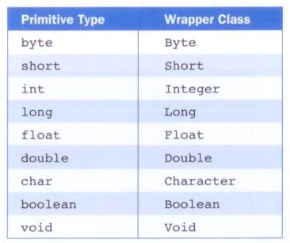
8. Wrapper Classes
The java.lang package contains wrapper classes that correspond to each primitive type:

Slide 70
The following declaration creates an Integer object:
Integer age = new Integer(40);
An object of a wrapper class can be used in any situation where a primitive value will not suffice.
For example, some objects serve as collections of other objects.
Primitive values could not be stored in such collections, but wrapper objects could be.

Slide 71
Wrapper classes also contain static methods that help manage the associated type.
For example, the Integer class contains a method to convert an integer stored in a String to an int value:
num = Integer.parseInt(str);
The wrapper classes often contain useful constants as well.
For example, the Integer class contains MIN_VALUE and MAX_VALUE which hold the smallest and largest int values.

Slide 72
Convert integer to string
String n = '345';
How to convert n -> 345?
int m = Integer.parseInt(n);
int num = 123;
How to convert 123 → "123"?
String.valueOf(num)
"" + num
Integer.toString(num)

Slide 73
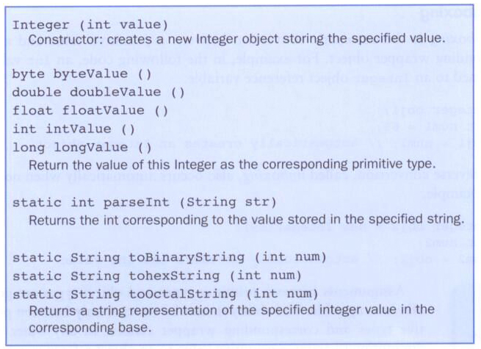
Some methods of the Integer class:
Should be toHexString(int num)

Slide 74
String num = '345.67';
How to convert num -> 345.67?
double m = Double.parseDouble(num);
Try this one. Conversion.java.

Slide 75
Autoboxing
Autoboxing is the automatic conversion of a primitive value to a corresponding wrapper object.
Integer obj;
int num = 42;
obj = num;
The assignment creates the appropriate Integer object.
The reverse conversion (called unboxing) also occurs automatically as needed.

Slide 76
Autoboxing and Unboxing

Slide 77
Any Questions?

